Slide 1
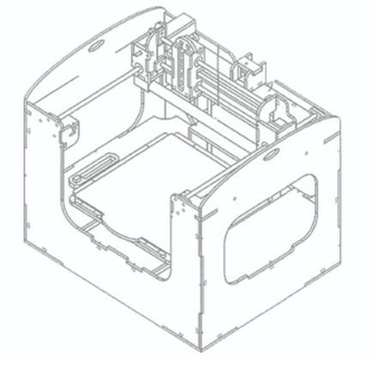
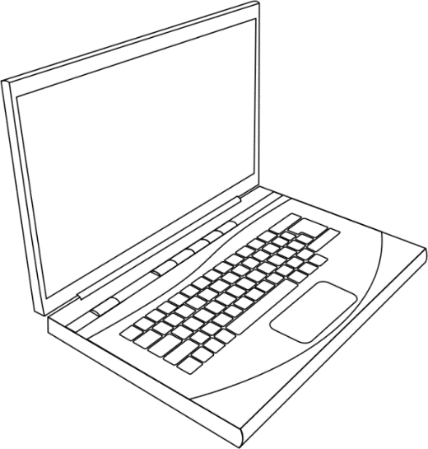




Studio
Print
XDFL Generation from inputted CAD Files
Optional XDFL Manipulation
Interpret XDFL to operate Scientist Printer

